Slide 1

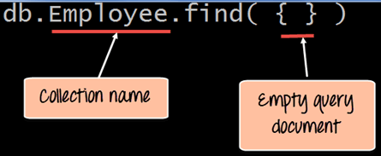
MongoDB Query Document using find() with Example
The method of fetching or getting data from a MongoDB database is carried out by using queries. While performing a query operation, one can also use criteria’s or conditions which can be used to retrieve specific data from the database.
MongoDB provides a function called db.collection.find () which is used for retrieval of documents from a MongoDB database
db.collection.find ()
employee is the collection name in the MongoDB database
The find command is an in-built function which is used to retrieve the documents in the collection.

Slide 2
MongoDB Query Document using find() with Example
We can also add criteria to our queries so that we can fetch documents based on certain conditions.
db.employee.find({EmployeeName : "Smith"})
db.employee.find({Employeeid : {$gt:2}}).forEach(printjson);

